Slide 1

Activities and Intents

Slide 2
Agenda
What you will learn in this module:
What activities are
How to apply styles and themes to activities
How to display activities as dialog windows
Understanding the concept of intents
How to use the Intent object to link activities
How intent filters help you to selectively connect to other activities
How to display alerts to the user using notifications

Slide 3
Activities
An activity represents a screen of information
An activity class extends the Activity base class
Each activity must be declared in the AndroidManifest.xml file

Slide 4
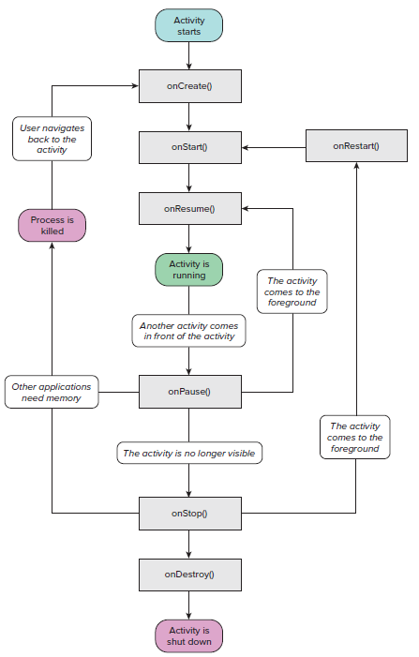
Activity Lifecycle

Slide 5
Exercise
Understanding the Life Cycle of an Activity
Page 30 of Beginning Android Application Development (Wrox)

Slide 6
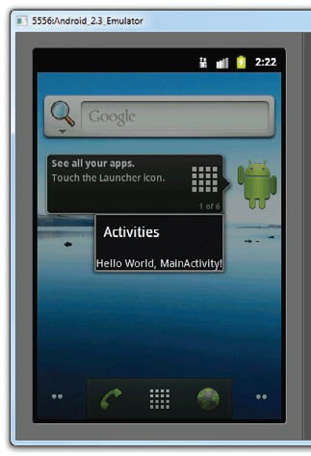
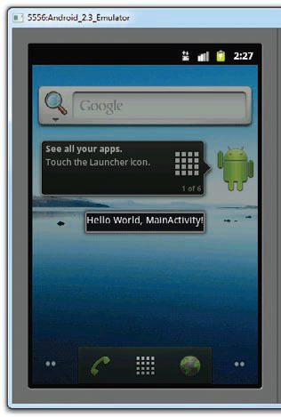
Styles and Themes
By default, an activity occupies the entire screen
You can apply styles and themes to change its look

Slide 7
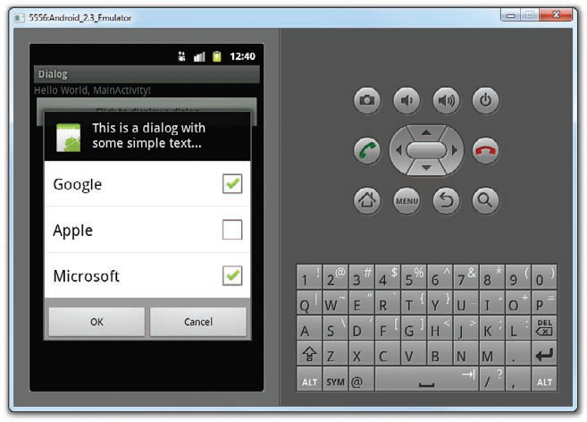
Exercise
Displaying a Dialog Window
Page 34 of Beginning Android Application Development (Wrox)

Slide 8
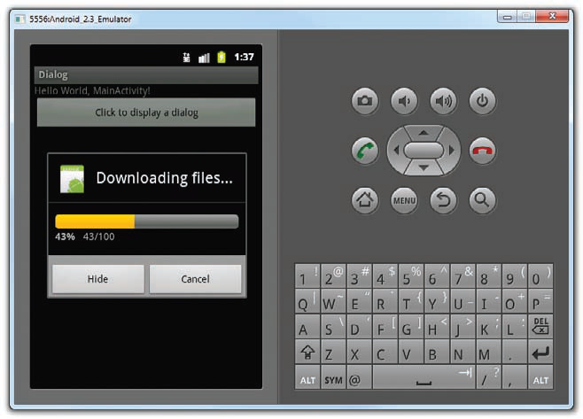
Exercise
Displaying a Progress Dialog
Page 39 of Beginning Android Application Development (Wrox)

Slide 9
Intents
Intent is the glue that connects activities
Allows one activity to link to another
Allows you to carry data and pass between activities
Allows you to call other activities from other applications
You use Intent Filter(s) to make your activities callable:
<activity android:name=”.Activity2” android:label=”Activity 2”>
<intent-filter>
<action android:name=”net.learn2develop.ACTIVITY2” />
<category android:name=”android.intent.category.DEFAULT” />
</intent-filter>
</activity>
Use startActivity() to call an activity

Slide 10
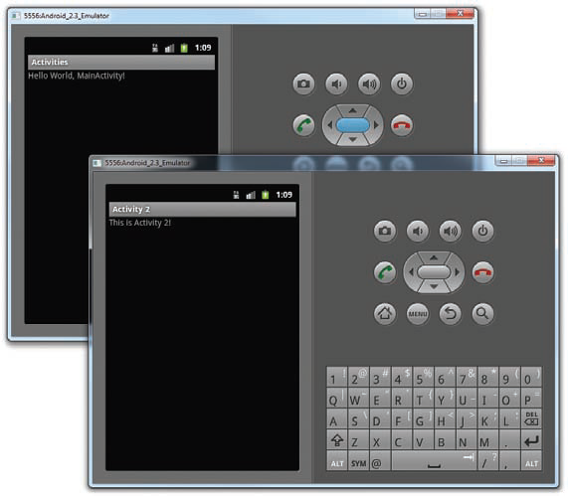
Exercise
Linking Activities using Intents
Page 43 of Beginning Android Application Development (Wrox)

Slide 11
Intent Filter Collision
Multiple activities may have the same intent filter(s)
Hence, recommend that you use the reverse domain name as the intent filter action
Collisions do occur:
<activity android:name=”.Activity2” android:label=”Activity 2”>
<intent-filter>
<action android:name=”net.learn2develop.ACTIVITY2” />
<category android:name=”android.intent.category.DEFAULT” />
</intent-filter>
</activity>
<activity android:name=”.Activity3” android:label=”Activity 3”>
<intent-filter>
<action android:name=”net.learn2develop.ACTIVITY2” />
<category android:name=”android.intent.category.DEFAULT” />
</intent-filter>
</activity>

Slide 12
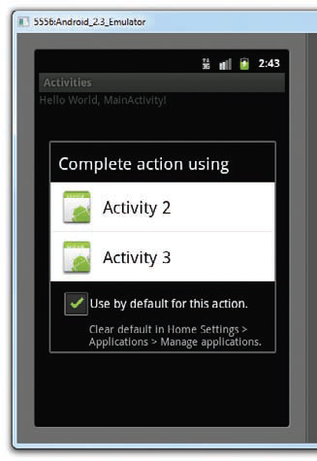
Identical Intent Filter

Slide 13
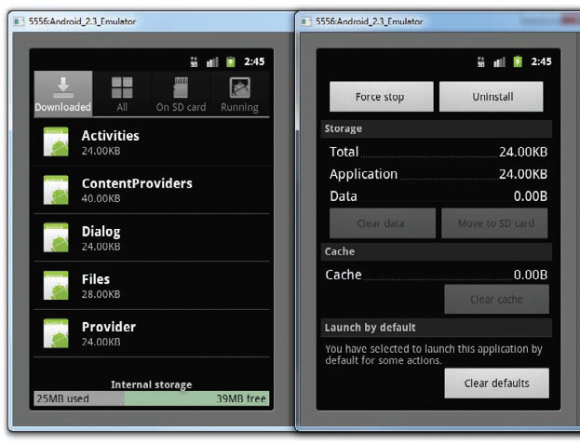
Undoing the Defaults

Slide 14
Returning Results
startActivity() does not return a result
Use startActivityForResult() to return a result from an activity
Useful for data collection
Implement the onActivityResult() method to obtain the returned result:
public void onActivityResult(int requestCode,
int resultCode, Intent data)
{
//---code to handle the result returned---
}

Slide 15
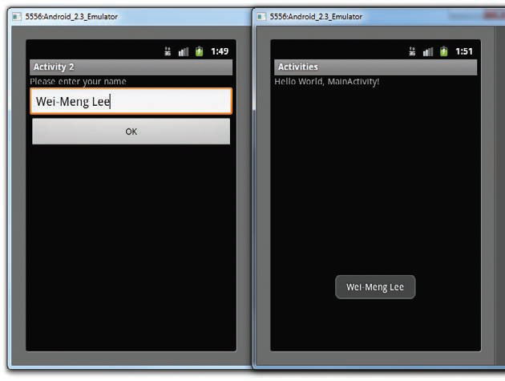
Exercise
Obtaining a Result from an activity
Page 50 of Beginning Android Application Development (Wrox)

Slide 16
Passing Data
Use a Bundle object to store dictionary objects
Attach the Bundle object to the Intent object:
Intent i = new
Intent(“net.learn2develop.ACTIVITY2”);
Bundle extras = new Bundle();
extras.putString(“Name”, “Your name here”);
i.putExtras(extras);
startActivityForResult(i, 1);

Slide 17
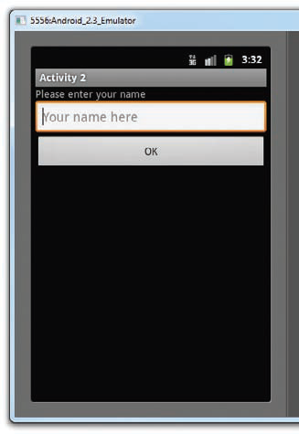
Exercise
Passing Data to the Target Activity
Page 54 of Beginning Android Application Development (Wrox)

Slide 18
Calling Built-In Apps
Use an Intent object
Specify the action and data
Example actions: ACTION_VIEW, ACTION_DIAL, ACTION_PICK
Data contains the scheme, e.g. tel:+651234567
Optionally you can also specify the type of data to return from the called application
Example:
Intent i = new
Intent(android.content.Intent.ACTION_PICK);
i.setType(ContactsContract.Contacts.CONTENT_TYPE);
startActivityForResult(i,request_Code);
The action/data pair describes the operation to be performed:
Intent i = new
Intent(android.content.Intent.ACTION_VIEW,
Uri.parse(“http://www.amazon.com”));
startActivity(i);

Slide 19
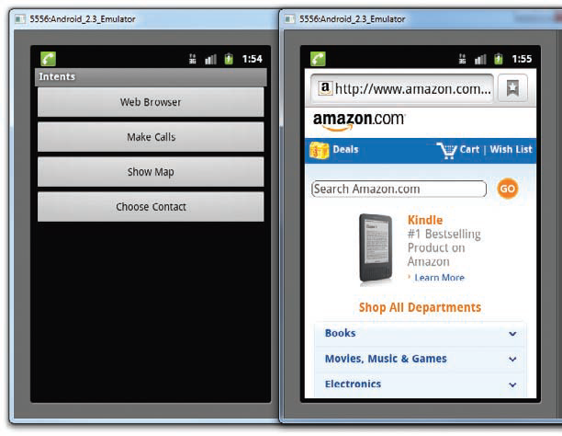
Exercise
Calling Built-in Applications Using Intents
Page 56 of Beginning Android Application Development (Wrox)

Slide 20
Category and Scheme
Category lets you group your activities into groups
Scheme lets you define the type of data you can deal with:
<activity android:name=”.MyBrowserActivity”
android:label=”@string/app_name”>
<intent-filter>
<action android:name=”android.intent.action.VIEW” />
<action android:name=”net.learn2develop.MyBrowser” />
<category android:name=”android.intent.category.DEFAULT” />
<category android:name=”net.learn2develop.Apps” />
<data android:scheme=”http” />
</intent-filter>
</activity>
You use the addCategory() method to specify a category when calling that activity:
Intent i = new Intent(android.content.Intent.ACTION_VIEW,
Uri.parse(“http://www.amazon.com”));
i.addCategory(“net.learn2develop.Apps”);
startActivity(i);

Slide 21
Displaying Notifications
The Toast class displays a non-persistent message to the user
A more persistent way to display notifications is to use the NotificationManager to display a message on the status bar

Slide 22
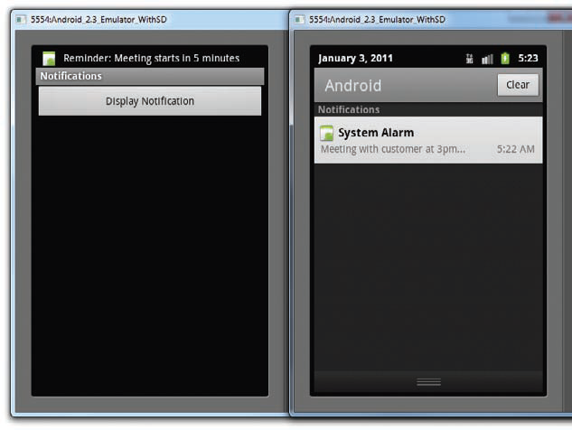
Exercise
Displaying Notifications on the Status Bar
Page 73 of Beginning Android Application Development (Wrox)

